Slide 1
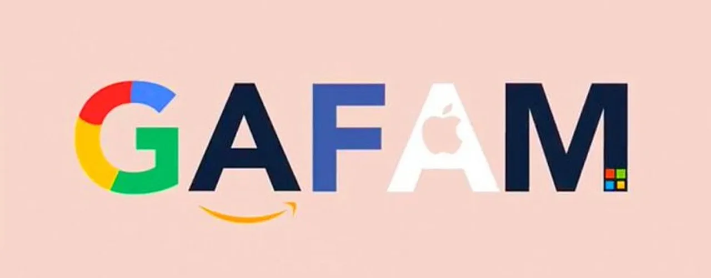
Partial Demo: Modeling and Predicting GAFAM M&A Strategy
By: Alex Dillon

Slide 2
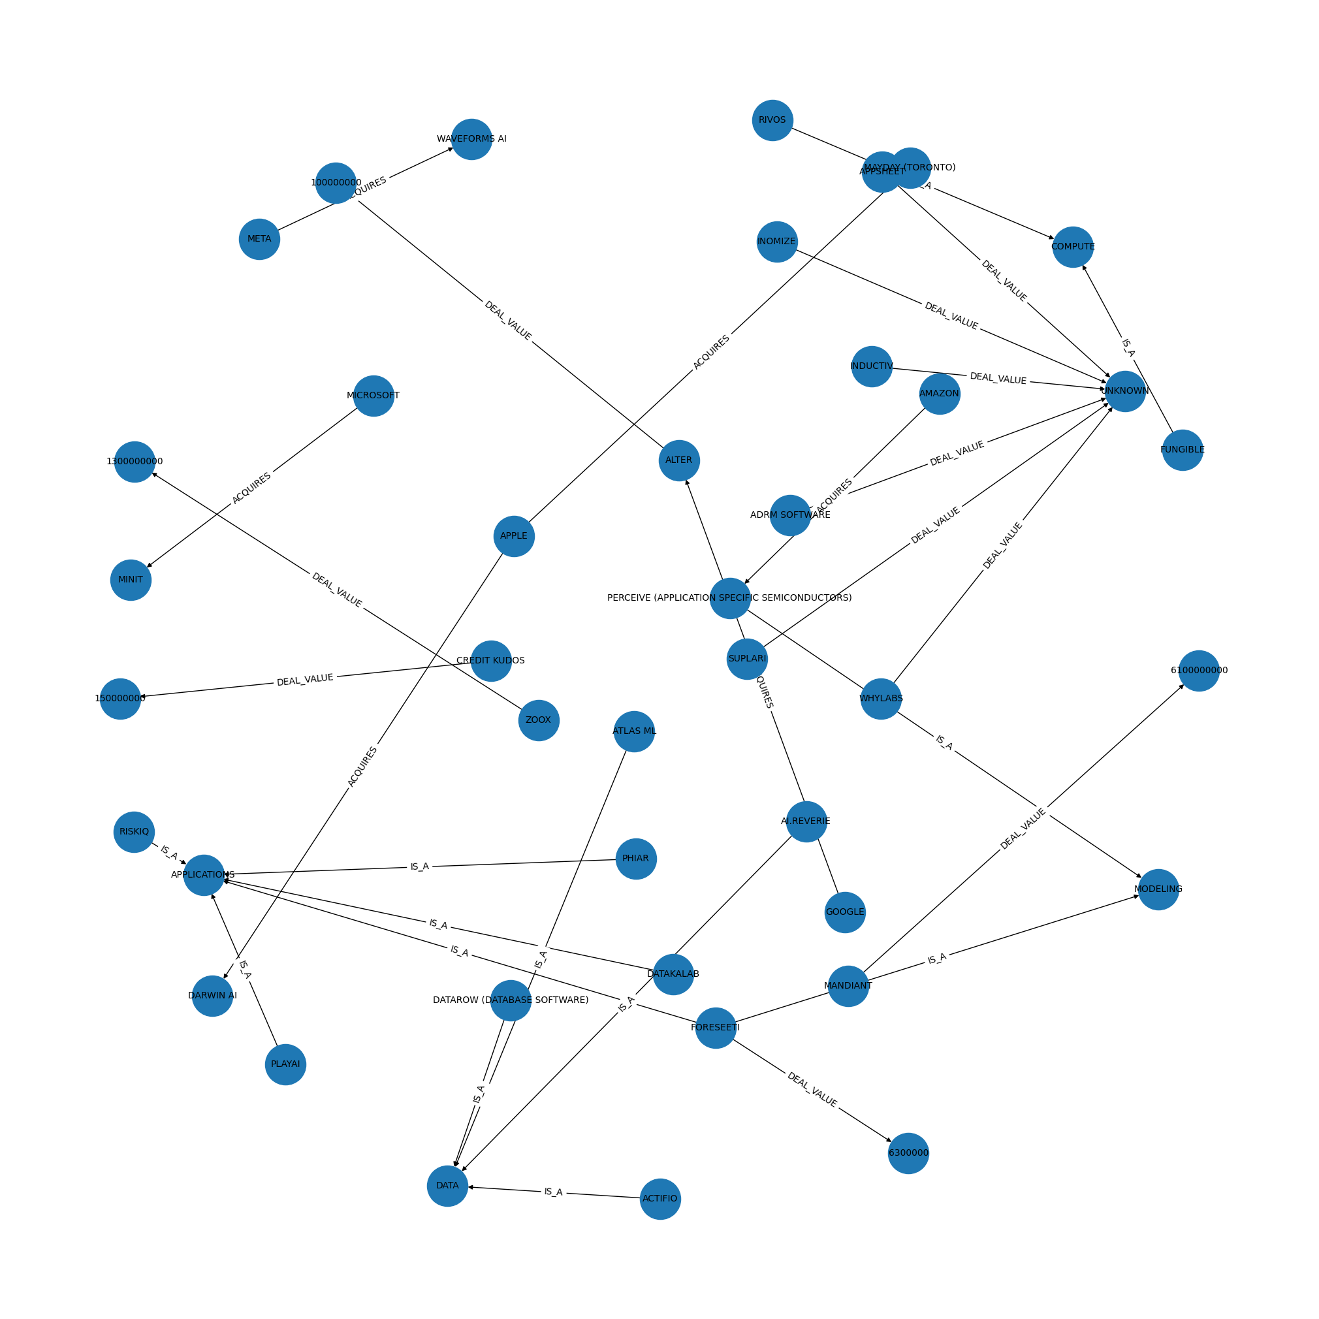
Dataset Overview/Knowledge Graph Data
SUBJECT | PREDICATE | OBJECT | DATE
META | ACQUIRES | MANUS AI | 29/12/2025
MANUS AI | IS_A | APPLICATIONS
MANUS AI | DEAL_VALUE | 2,000,000,000
APPLE | ACQUIRES | Q.AI | 29/1/2026
Q.AI | IS_A | MODELING
Q.AI | IS_A | APPLICATIONS
Q.AI | DEAL_VALUE | 2,000,000,000
Notes:
This dataset comes from PitchBook and includes AI-related acquisitions made by GAFAM companies between 2020 and early 2026. Each row records the acquiring company, the acquired company, deal value when available, and the sector of AI in which the company operates.
Instead of analyzing these acquisitions only as rows in a spreadsheet, I convert the dataset into a knowledge graph. In the graph, companies are linked to the AI firms they acquire, and each acquired firm is categorized by its area of AI focus, such as Applications, Modeling, or Data, allowing us to analyze strategic investment patterns.
This allows me to represent acquisition strategy as a network of relationships across the AI ecosystem rather than as isolated transactions, and this structure is later used for embedding-based prediction using TransE.

Slide 3
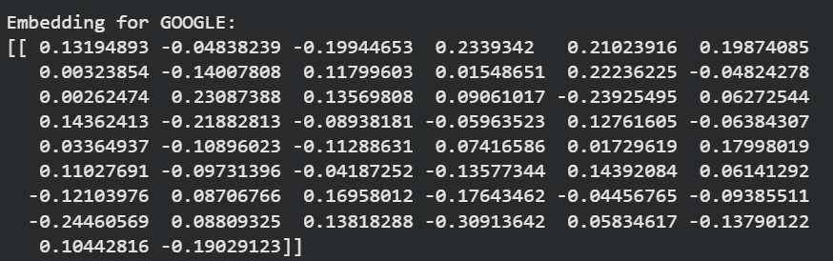
Learning Company Embeddings
TransE maps companies and relationships in vectors
Captures patterns in acquisitions, which types of companies each firm targets
Embeddings allow the model to predict new potential acquisitions
Trained using the dataset of triples (head, relationship, tail)
GOOGLE
ACQUIRES
MANUS AI
MANUS AI
IS_A
APPLICATIONS
Notes:
Here we use TransE to convert our knowledge graph into vector embeddings, which means each company and relationship is represented as a position in a numerical space. The model learns these positions so that companies with similar acquisition behavior are located close together, allowing it to identify patterns in which types of companies each firm tends to acquire.
During training, the model learns from triples in the dataset — like ‘Google acquires Manus AI or ‘Manus AI is a Applications company’ — and positions the vectors so that the relationship from one company points toward the company it acquired. Companies that acquire similar types of firms end up close together in this space, and relationships capture the direction and type of acquisition. For example, here is Google’s embedding, which represents its acquisition behavior in vector form.
Once trained, we can use these embeddings to predict potential acquisitions by seeing which companies are closest to a firm in vector space along the acquisition relationship. Essentially, the model learns the ‘map’ of acquisition behavior across the AI ecosystem and allows us to make informed predictions about what a company might acquire next.

Slide 4
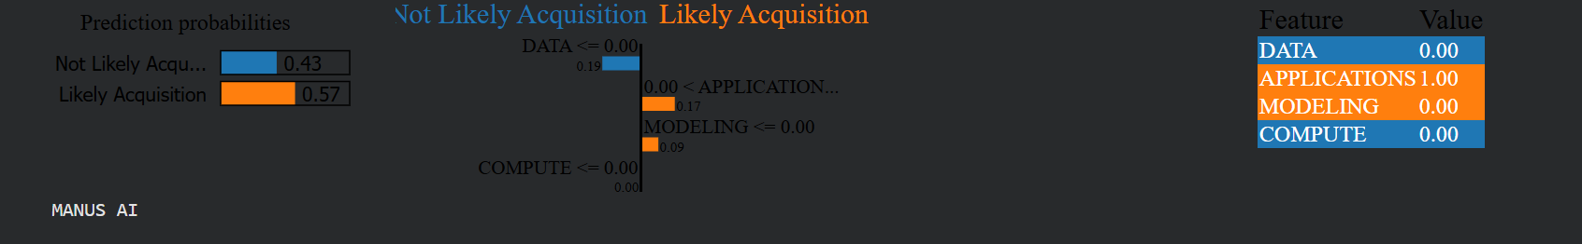
Predicting Acquisitions and Explaining with Lime
tail_id | score | tail_label
36 | -5.564336 | ATLAS ML
93 | -5.831578 | SCAPE
104 | -5.924926 | WAVEFORMS AI
… | … | …
61 | -9.939092 | GOOGLE
73 | -9.986247 | MICROSOFT
31 | -10.342355 | APPLE
The TransE model scores how likely a triple is based on patterns in the M&A data
High scores indicate that the acquisition fits patterns for that firm
LIME highlights which features contribute most to the prediction
Can be used to suggest future acquisitions, even for companies not acquired yet
Notes:
The Table: These numbers are prediction scores from the TransE model. Each row is an acquisition that actually happened, with the ‘tail label’ showing the acquired company. The score shows how well that acquisition aligns with the patterns the model has learned from all M&A data — basically, how typical it is for this firm.
Higher scores — closer to zero here — mean the acquisition is very consistent with the firm’s usual targets. Lower scores indicate acquisitions that are less typical or unusual.
LIME Output: LIME explains why the model gave a particular score. For each acquisition, it breaks down which features — in this case, AI categories — influenced the model. For example, this company is an Applications company, which is why APPLICATIONS is 1.0. The other numbers, like 0.17 for Modeling or 0.19 for Data, show how much each feature pushed the model toward or away from predicting this as a typical acquisition.
We also see the model’s classification as “Likely Acquisition” with a probability of 0.57. This doesn’t predict the future — it shows how consistent the acquisition is with the firm’s learned patterns and which features drive that consistency.

Slide 5
Conclusion
Knowledge Graph
Predictions
Embeddings
Lime Explanation
Moving Forward/Future Work
Notes:
We built a knowledge graph of AI acquisitions to capture relationships across companies, rather than looking at isolated deals.
Using TransE, we learned company embeddings that represent acquisition patterns and preferences.
The model can score acquisitions based on consistency with these patterns, and LIME explains which features — like AI categories — drive the prediction.
This approach reveals not just what acquisitions happen, but why they fit a firm’s overall strategy, providing insights into acquisition behavior in the AI ecosystem.
Moving Forward
Expand the target set – include companies that haven’t been acquired yet so you can generate true predictions.
Adding acquisition year as a feature: For each acquired company, we can include the year it was acquired as a feature in our knowledge graph. This lets us see not just what kinds of companies a firm buys, but when they buy them.
Analyzing embeddings over time: Once we have the year information, we can group acquisitions by year and look at how the patterns in embeddings change over time. For example, we might see that a firm starts acquiring more Modeling companies after 2018, showing a shift in their acquisition strategy. This gives us a way to track trends in AI acquisitions year by year.
Compare across GAFAM firms Look at patterns for each firm individually and see how their strategies differ. For example, maybe Google focuses on Modeling and Data companies, while Microsoft leans more toward Applications. This can help contextualize trends.

